Slide 1
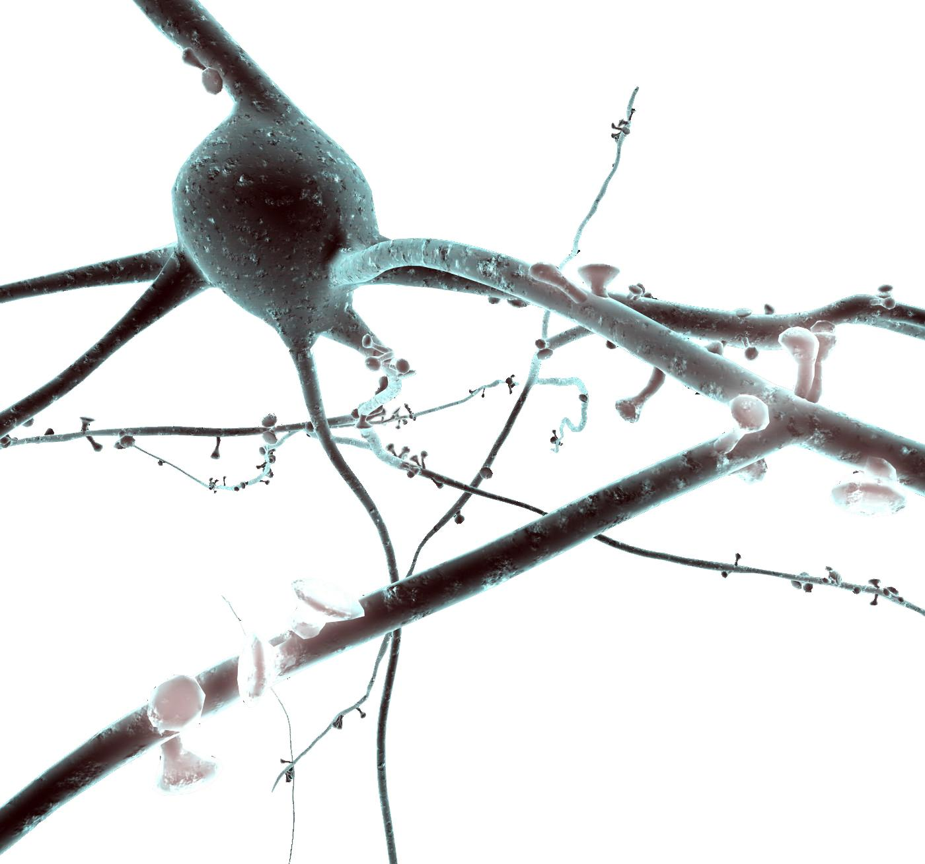
Using NEURON to model cells Tutorial
Darshan Mandge
Darshan.mandge@epfl.ch
Blue Brain Project
Tutorial adapted from Oren Amsalem, Yoni Leibner (Idan Segev Lab) and András Ecker (BBP)

Slide 2
Introduction
The NEURON Simulation Environment is designed for modeling individual neurons and networks of neurons.
It is particularly well-suited to explore problems which are closely linked to experimental data.
NEURON was built and is maintained by Ted Carnevale and Michael Hines at Yale. The Blue Brain Project is also heavily involved with the development of the software
Neuron is written in C & C++, the interface with the simulator is with HOC, but a Python wrapper was build and now commonly used instead of HOC (NEURON as a python package). In addition User-defined mechanisms such as voltage- and ligand-gated ion channels are used in order to expand NEURON (NMODL files, need to be compiled).
In this presentation we will show the following examples:
Single compartment model
Ball and Stick model and the replication of a published result (Gidon et al.)
Multicompartmental L5 Pyramidal cell and two published results (Hay et al., Doron et al.)

Slide 3
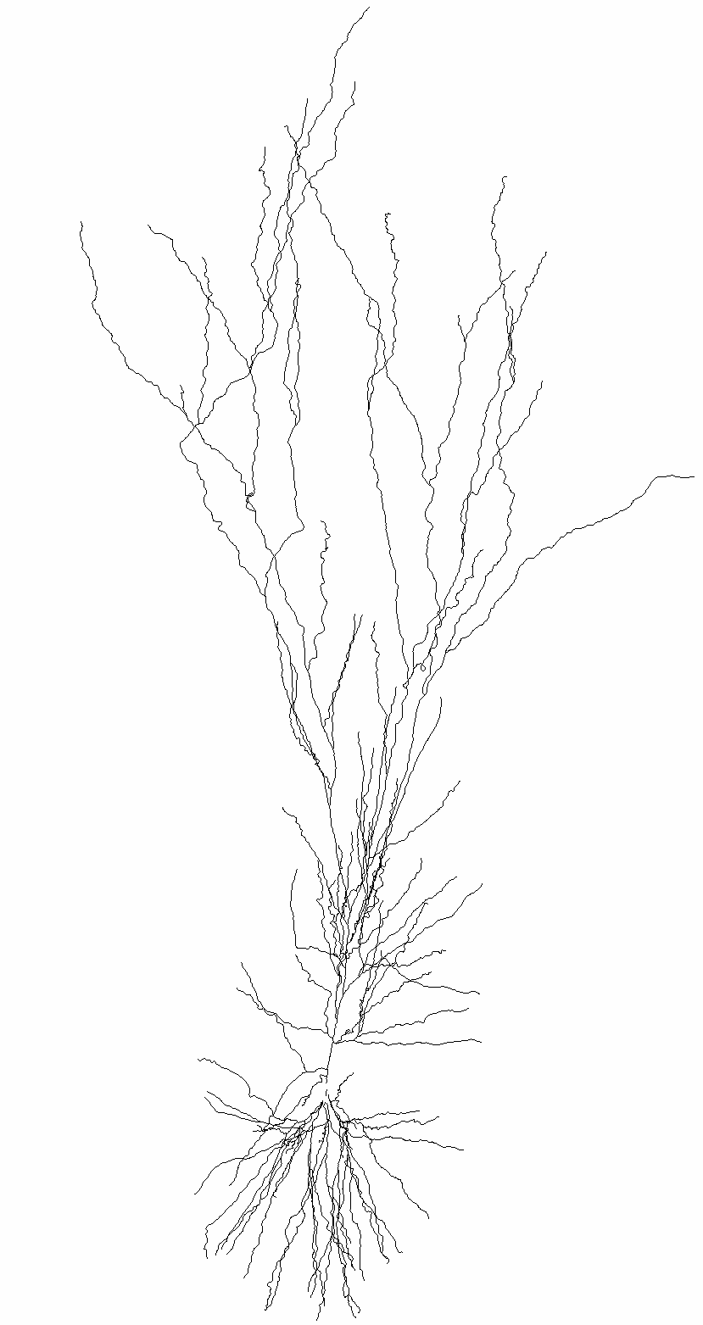
Introduction
Basic concepts of Neuron models:
Model - a Neuron object, it can have soma, basal dendrites (dend) and apical dendrite (apic).
Section - more of a morphological definition, a section is usually a dendrite between 2 bifurcation points.
Segment - one RC circuit that resemble (approximate) the computation in a piece of membrane.
Clamps - an object that represent an experimental electrode.
Synapses - object that resemble a single synapse (we will see it later, and how it’s activated in the simulation).
Distributed Process: generally ion channels spread on the membrane
Point Process - a more general idea, it’s an object that seats on the segment (RC circuit), and simulate clamps, synapses, etc.

Slide 4
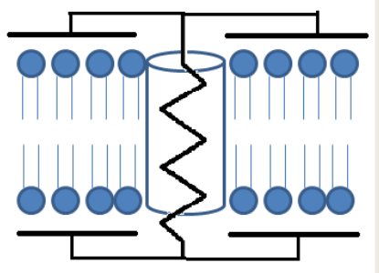
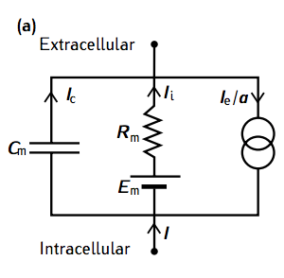
Single compartment neuron - single RC circuit
Neuron Cell Membrane
Equivalent Circuit
from neuron import h, gui
# create model
soma = h.Section(name="soma")
soma.L = 10 # length µm
soma.diam = 10 # diameter µm
soma.insert('pas’). # add passive properties
soma.g_pas = 1/10000 # set the specific membrane
resistance to 10000 ohm*cm^2
# current current clamp
stim = h.IClamp(soma(0.5))
stim.delay = 20. # start of the current injection (ms)
stim.dur = 100 # duration (ms)
stim.amp = 0.01 # amplitude (nA)
0_soma_passive.ipynb

Slide 5
Single compartment neuron - recording
# record injected current soma voltage (and time)
soma_v = h.Vector()
soma_v.record(soma(0.5)._ref_v)
stim_current = h.Vector()
stim_current.record(stim._ref_i)
t = h.Vector()
t.record(h._ref_t)
# run simulation
h.tstop = 220 # simulation time (ms)
h.dt = 0.025.
h.v_init = -70. # initial voltage (mV)
h.run()

Slide 6
Single compartment neuron - synapse
# add a synapse
synapse = h.Exp2Syn(soma(0.5))
synapse.tau1 = 0.3 # rise time constant
synapse.tau2 = 1.8 # decay time constant
stim = h.NetStim()
stim.number = 1
stim.noise = 0 # no noise
stim.interval = 1
net_con = h.NetCon(stim, synapse)
net_con.weight[0]= 0.0004 # the maximal conductance of the synapse

Slide 7
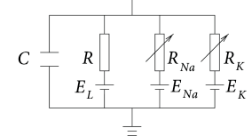
Single compartment neuron – active conductances
from neuron import h, gui
# create model
Soma = h.Section(name="soma")
soma.L = 10 # length µm
soma.diam = 10 # diameter µm
soma.insert("pas"). # add passive properties
soma.g_pas = 1/10000 # set the specific membrane
resistance to 10000 ohm*cm^2
soma.insert(”kv") # add potassium channel
(from a mod file)
soma.gbar_kv = 2000 # set the potassium conductance
soma.insert(”na") # add sodium channel (from a mod file)
soma.gbar_na = 8000 # set the sodium conductance
h.celsius = 30. # set temperature
1_soma_active.ipynb

Slide 8
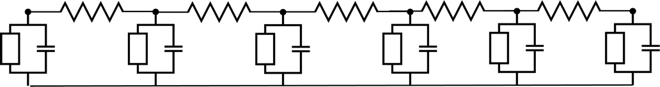
Moving towards the cable model
# create dendrite
dend = h.Section(name=”dend")
dend.L = 500 # um
dend.diam = 1 # um
dend.Ra = 100 # ohm*cm
dend.insert(”pas")
dend.g_pas = 1/10000
dend.connect(soma, 1, 0). # connect the end of
the dendrite to the beginning of the soma
h"forall { nseg = int((L/(0.1*lambda_f(100))+0.9)/2)*2 + 1 }")
# set the number of segments
Dendrite
dend(0.1).v
dend(0.4).v
Dendrite
synaptic input
2_soma_dend_step_current.ipynb
3_soma_dend_synapse.ipynb
Note: d_lambda rule – NEURON Book chapter 4

Slide 9
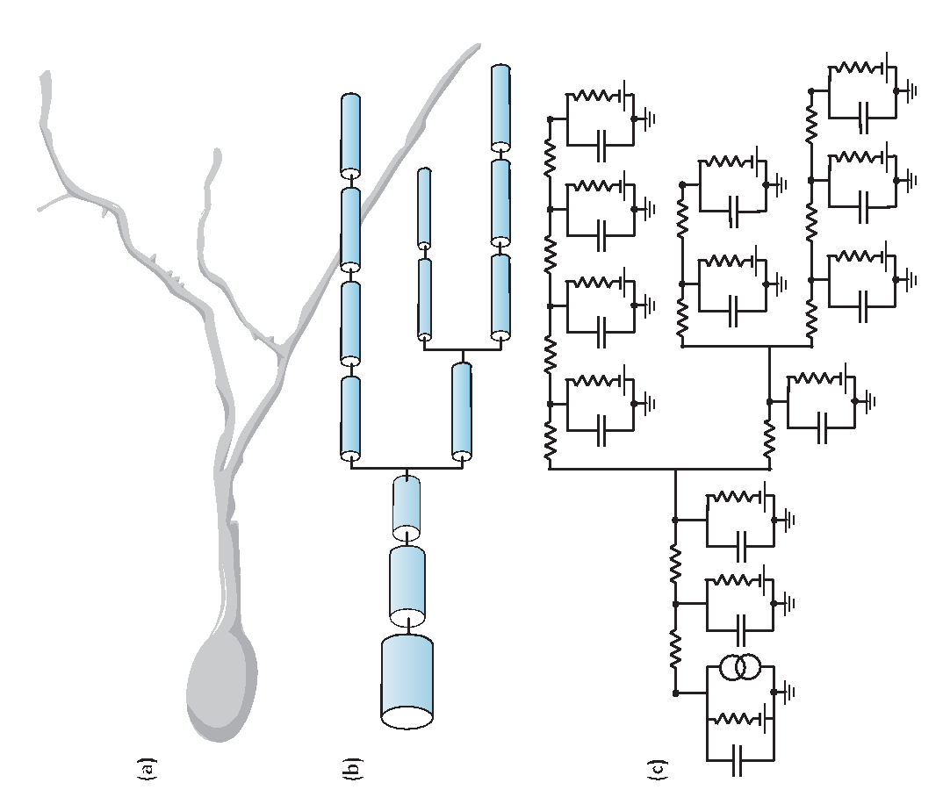
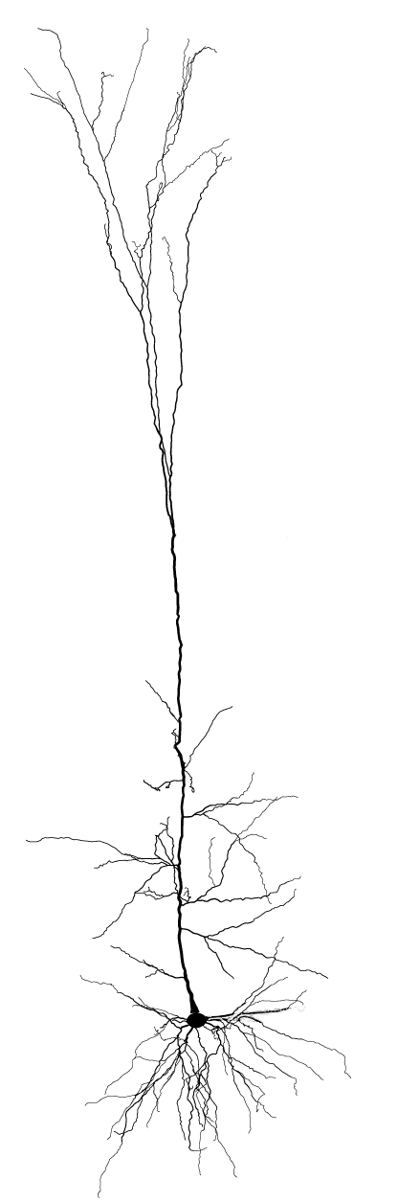
Layer 5b Pyramidal Cell
from neuron import h, gui
# instantiating cell
h.load_file("import3d.hoc")
h.load_file("models/L5PCbiophys3.hoc")
h.load_file("models/L5PCtemplate.hoc")
morph_fname = "morphologies/cell1.asc"
L5PC = h.L5PCtemplate(morph_fname)
4_L5_PC_Hay_et_al.ipynb
“Models of Neocortical Layer 5b Pyramidal Cells Capturing a Wide Range of Dendritic and Perisomatic Active Properties”, Etay Hay , Sean Hill, Felix Schürmann, Henry Markram, Idan Segev. PLOS Computational Biology, 2011

Slide 10
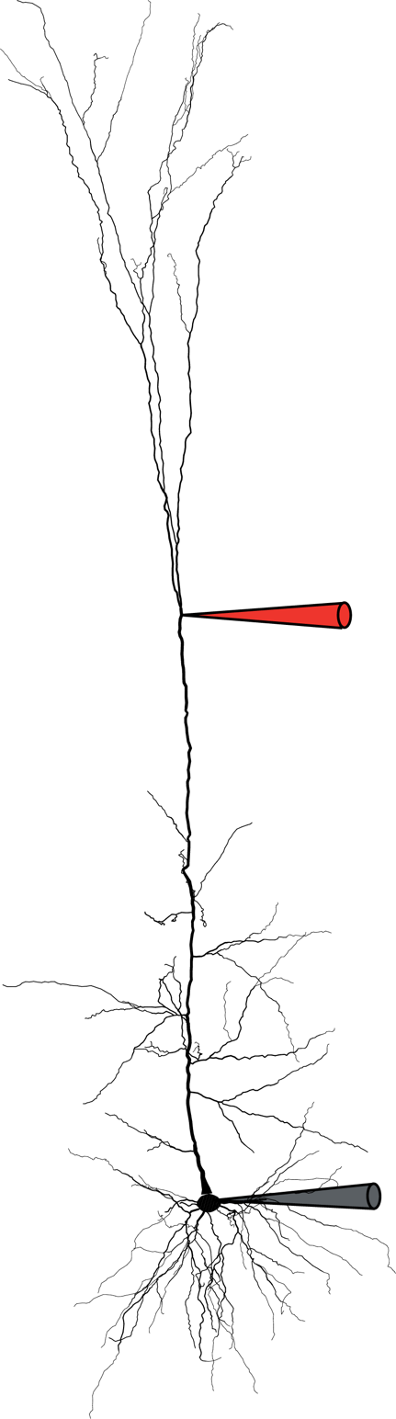
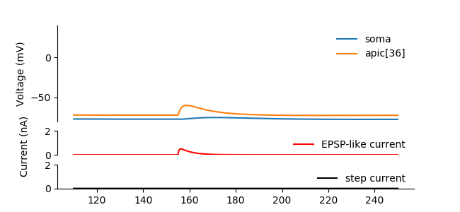
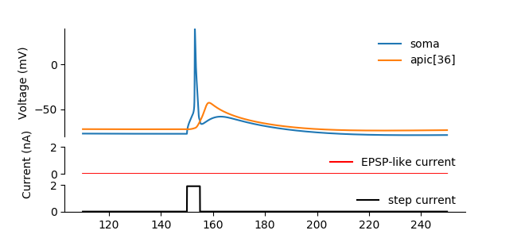

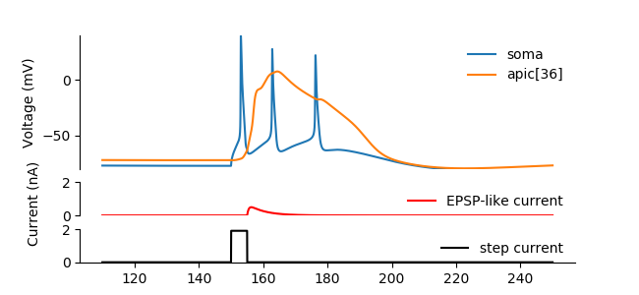

# Only EPSP-like current
syn.imax = 0.5
stim.amp = 0
h.run();
plot_result(...)
# Only small step current
syn.imax = 0
stim.amp = 1.9
h.run();
plot_result(...)
Recording
# both currents
syn.imax = 0.5
stim.amp = 1.9
h.run()
plot_result(...);
5_calcium_spike_Hay_et_al.ipynb
“Models of Neocortical Layer 5b Pyramidal Cells Capturing a Wide Range of Dendritic and Perisomatic Active Properties”, Etay Hay , Sean Hill, Felix Schürmann, Henry Markram, Idan Segev. PLOS Computational Biology, 2011

Slide 11
Layer 5b Pyramidal Cell
# place a single synapse
syn_loc = rng_pos.repick() apical_exc_syns.append(h.ProbAMPANMDA_EMS(sec(syn_loc)))
# create random stim. times
apical_exc_netstims.append(h.NetStim())
apical_exc_netstims[-1].number = t_stop / 1000 * exc_freq
apical_exc_netstims[-1].interval = 1000 / exc_freq # ms
apical_exc_netstims[-1].noise = 1 # make it Poisson like
# connect stimulator to the synapse
apical_exc_netconns.append(h.NetCon(apical_exc_netstims[-1], apical_exc_syns[-1]))
apical_exc_netconns[-1].weight[0] = gsyn_exc
6_random_synapses_Hay.ipynb

Slide 12
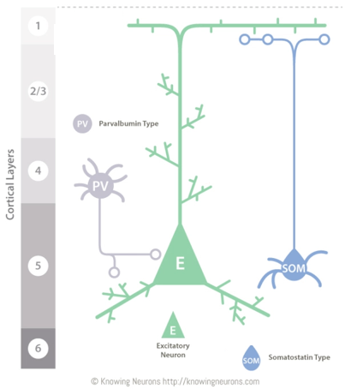
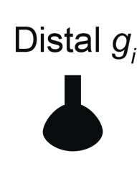

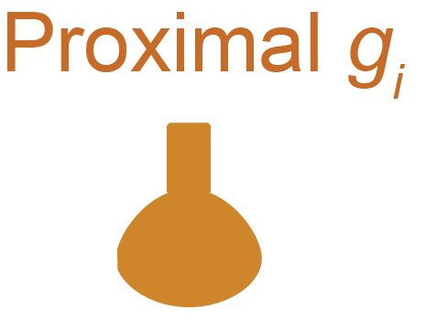

Inhibition location
+1_inhibition_location_Gidon_et_al.ipynb
“Principles Governing the Operation of Synaptic Inhibition in Dendrite” Albert Gidon, Idan Segev. Neuron, 2012

Slide 13
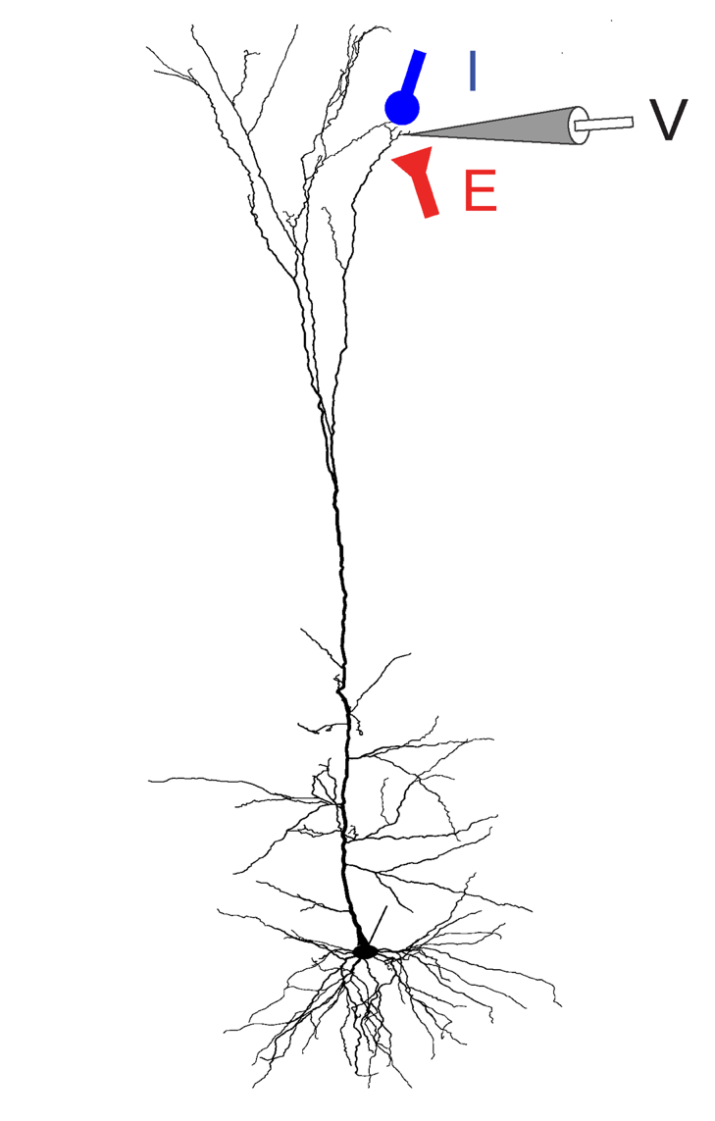
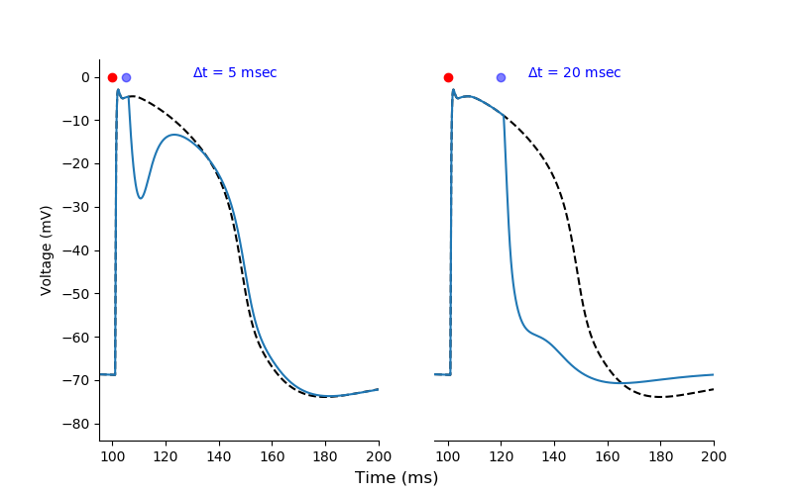
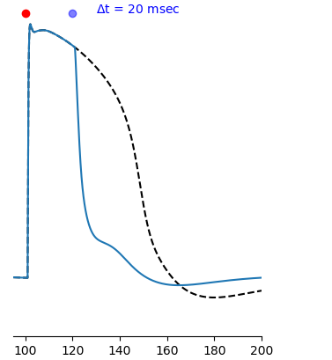
Timed inhibition
+2_timed_inhibition_Doron_et_al.ipynb
“Timed Synaptic Inhibition Shapes NMDA Spikes, Influencing Local Dendritic Processing and Global I/O Properties of Cortical Neurons” Michael Doron, Giuseppe Chindemi, Eilif Muller, Henry Markram, Idan Segev. Cell Reports, 2017

Slide 14
Useful links
NEURON: (GitHub)
Documentation: Python Doc, HOC Doc, ReadTheDocs
More scripting basics, NEURON-Python tutorials, courses and material
Queries: FAQs, NEURON Forum and GitHub issues
Modeling repositories
ModelDB (published models)
NeuroMoprho (morphologies)
Channelpedia and ICGenealogy (ion channels)
NeuroElectro (neuron parameters)
Others
Blue Brain Tools (for subcellular, cellular, circuit-level models among others)
Allen Institute Data and Tools
NetPyNE (modelling networks of neurons)
CoreNEURON (faster NEURON execution)
Free edx MOOCs: Simulation Neuroscience, Simulating a Hippocampus Microcircuit

Slide 15
Useful NEURON Tools and Tips
NEURON-Python scripting Basics
Units used in NEURON
NEURON Tips (mainly HOC)
Specifying temperature in NEURON h.celsius
Don’t forget to compile new mod files before running NEURON
Randomness in NEURON models
NEURON Sections overview

Slide 16
Blue Brain Project Software https://github.com/BlueBrain

Slide 17

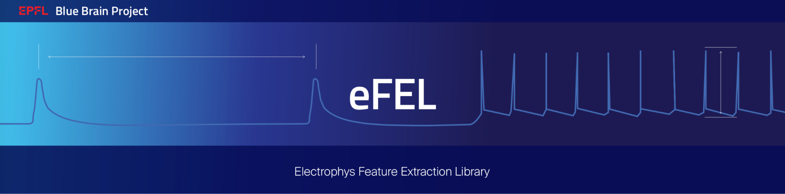
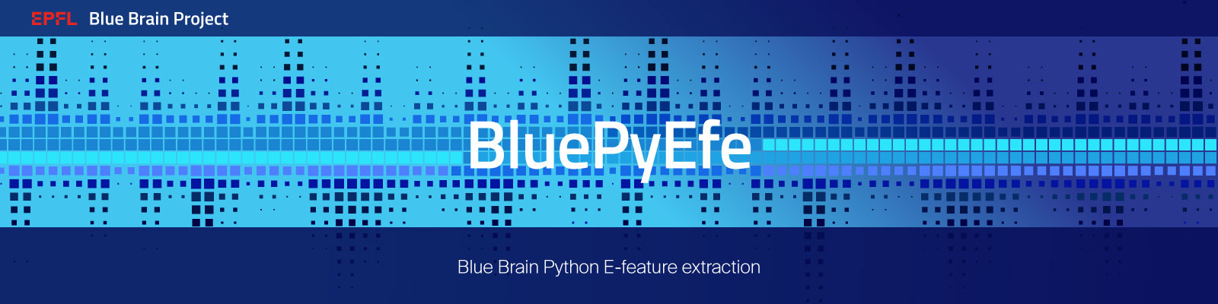
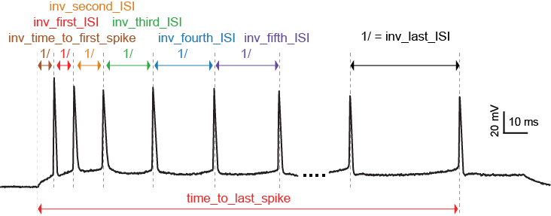
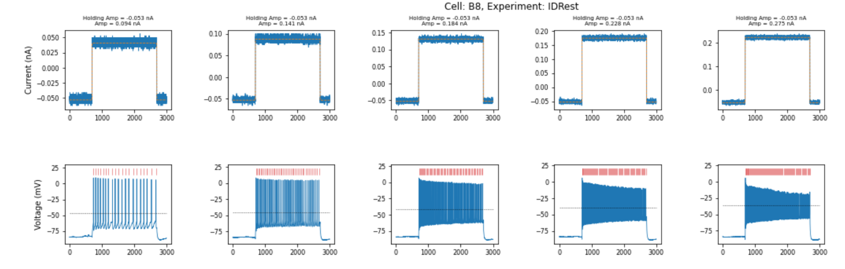
github.com/BlueBrain/eFEL
github.com/BlueBrain/BluePyEfe

Slide 18
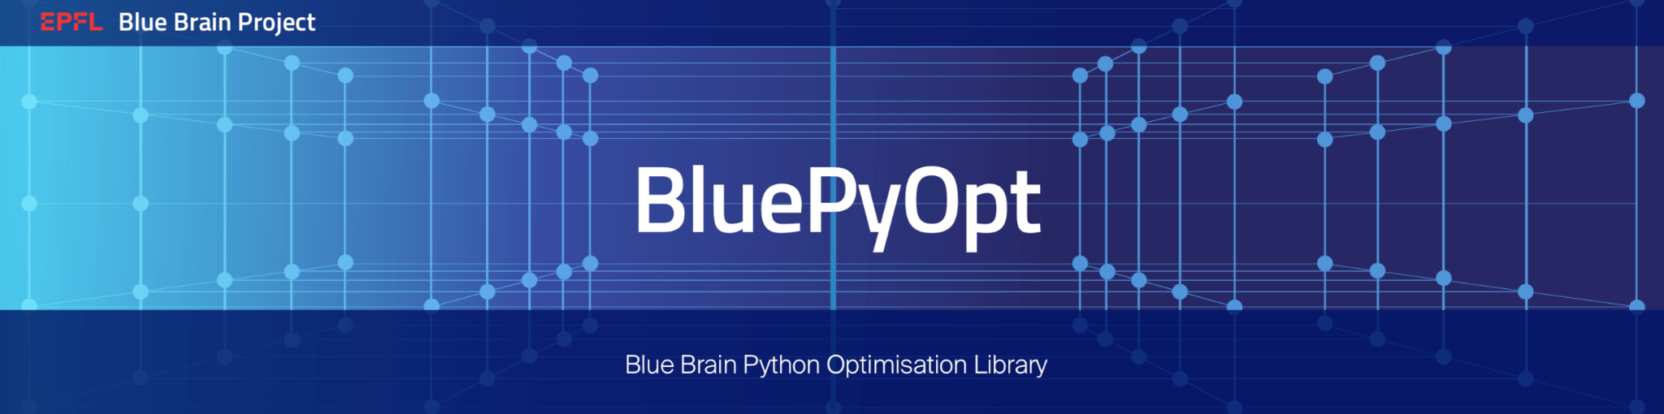

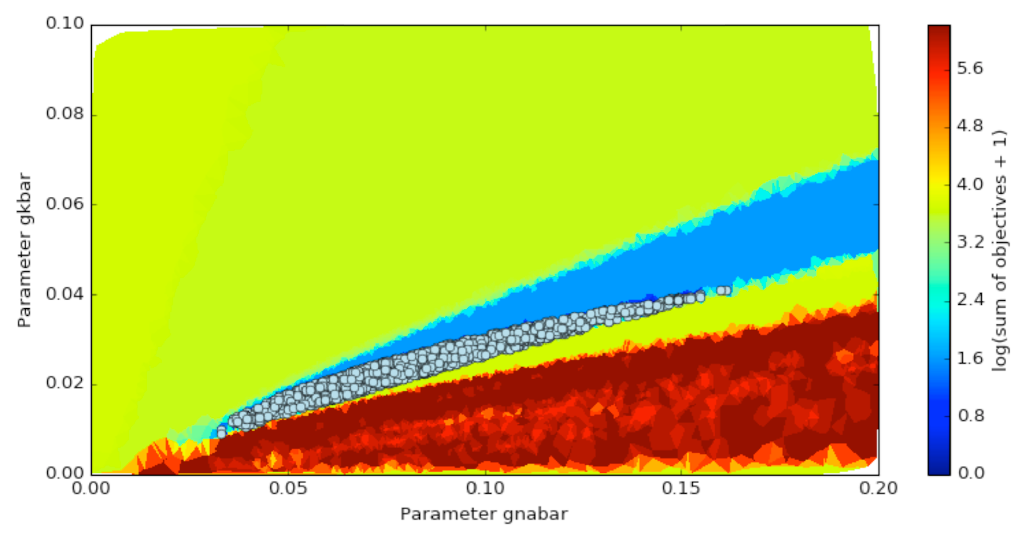
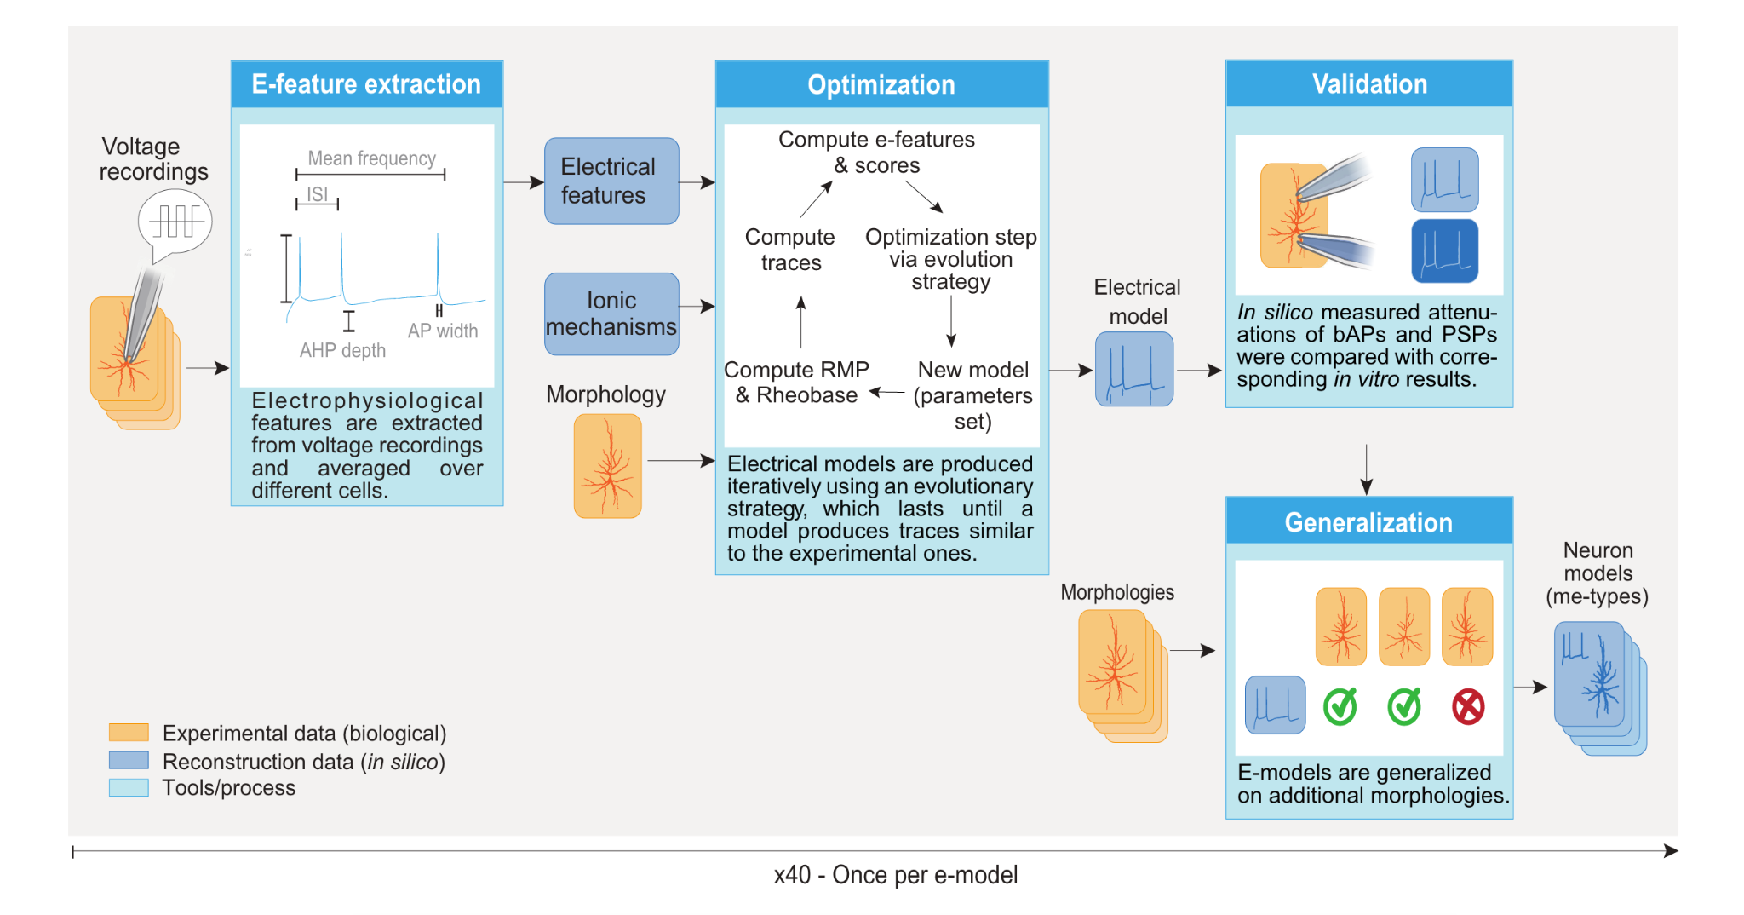
github.com/BlueBrain/BluePyOpt
github.com/BlueBrain/BluePyMM

Slide 19
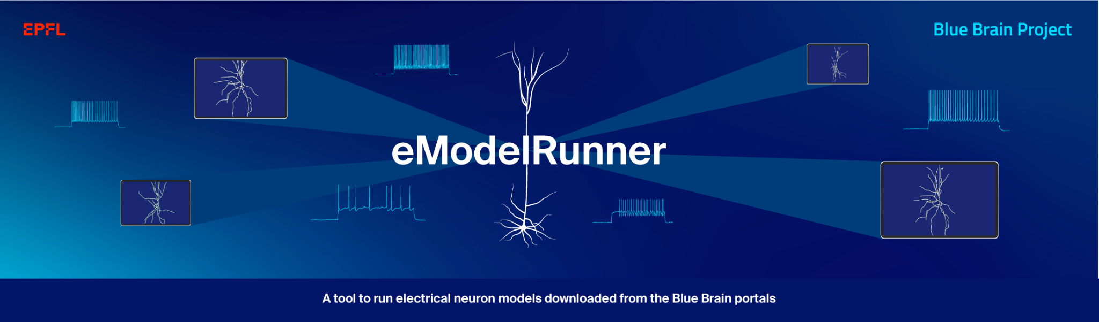
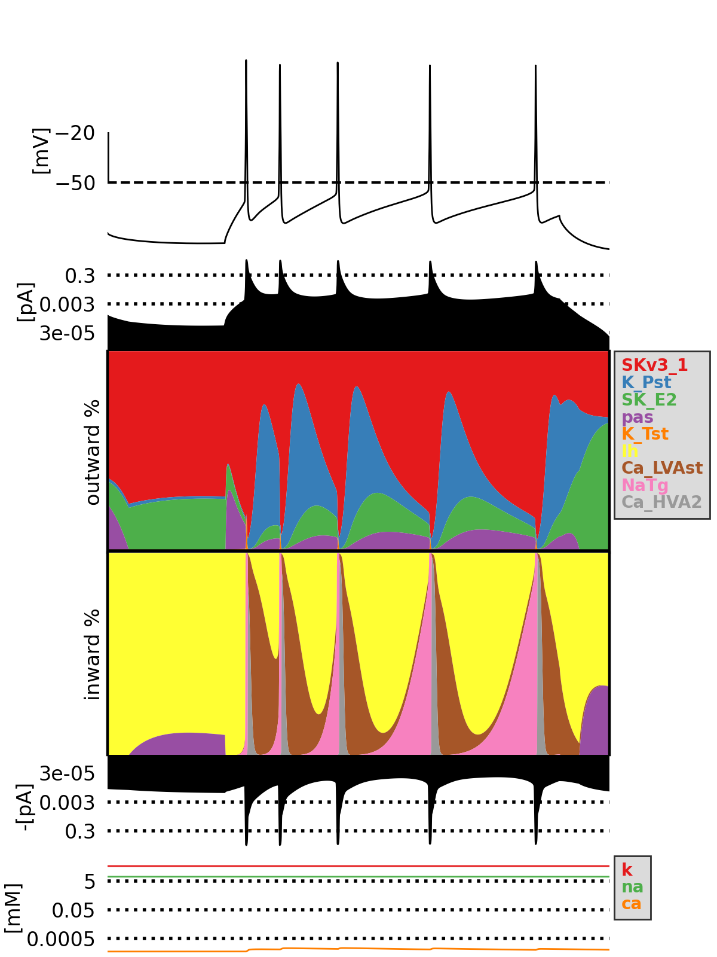
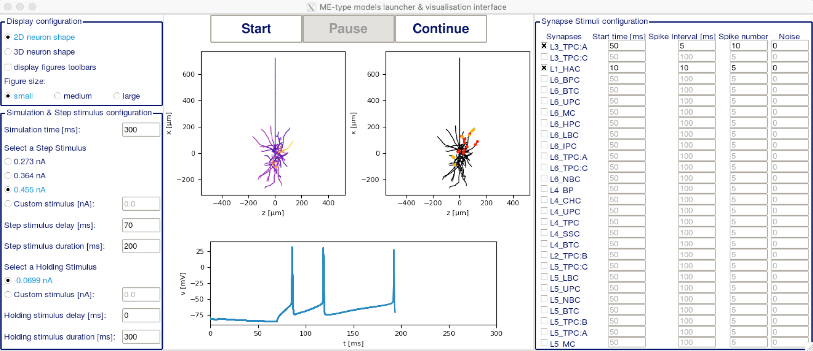
Currentscape
github.com/BlueBrain/EModelRunner
github.com/BlueBrain/Currentscape

Slide 20
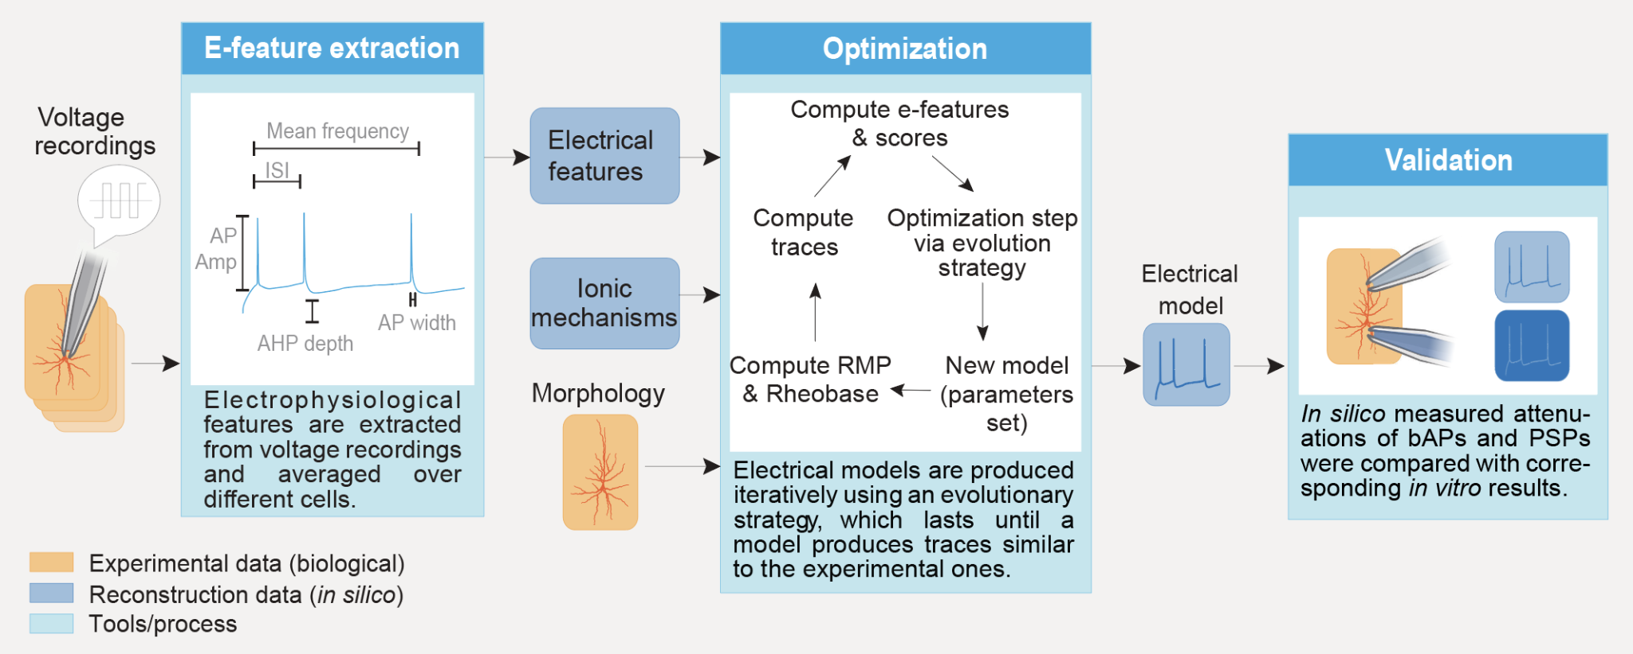
BluePyEModel
Unified detailed single cell model building software pipeline
Uses eFEL, BluePyEfe, BluePyOpt and Currentscape
github.com/BlueBrain/BluePyEModel

Slide 21
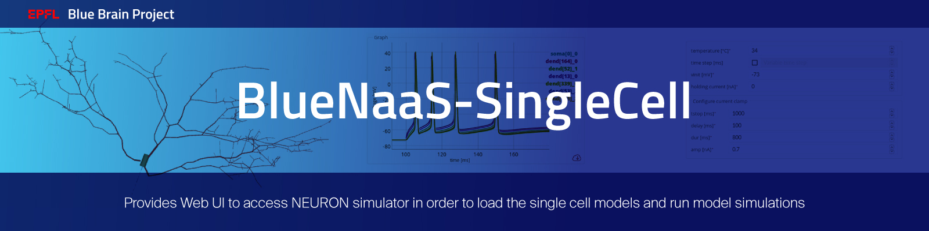
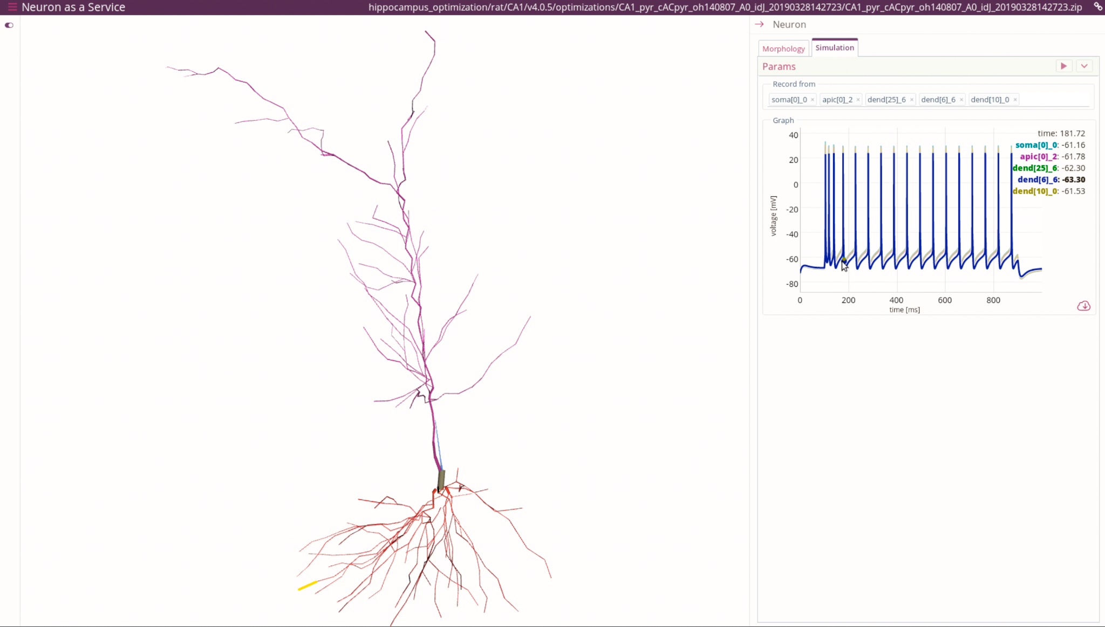
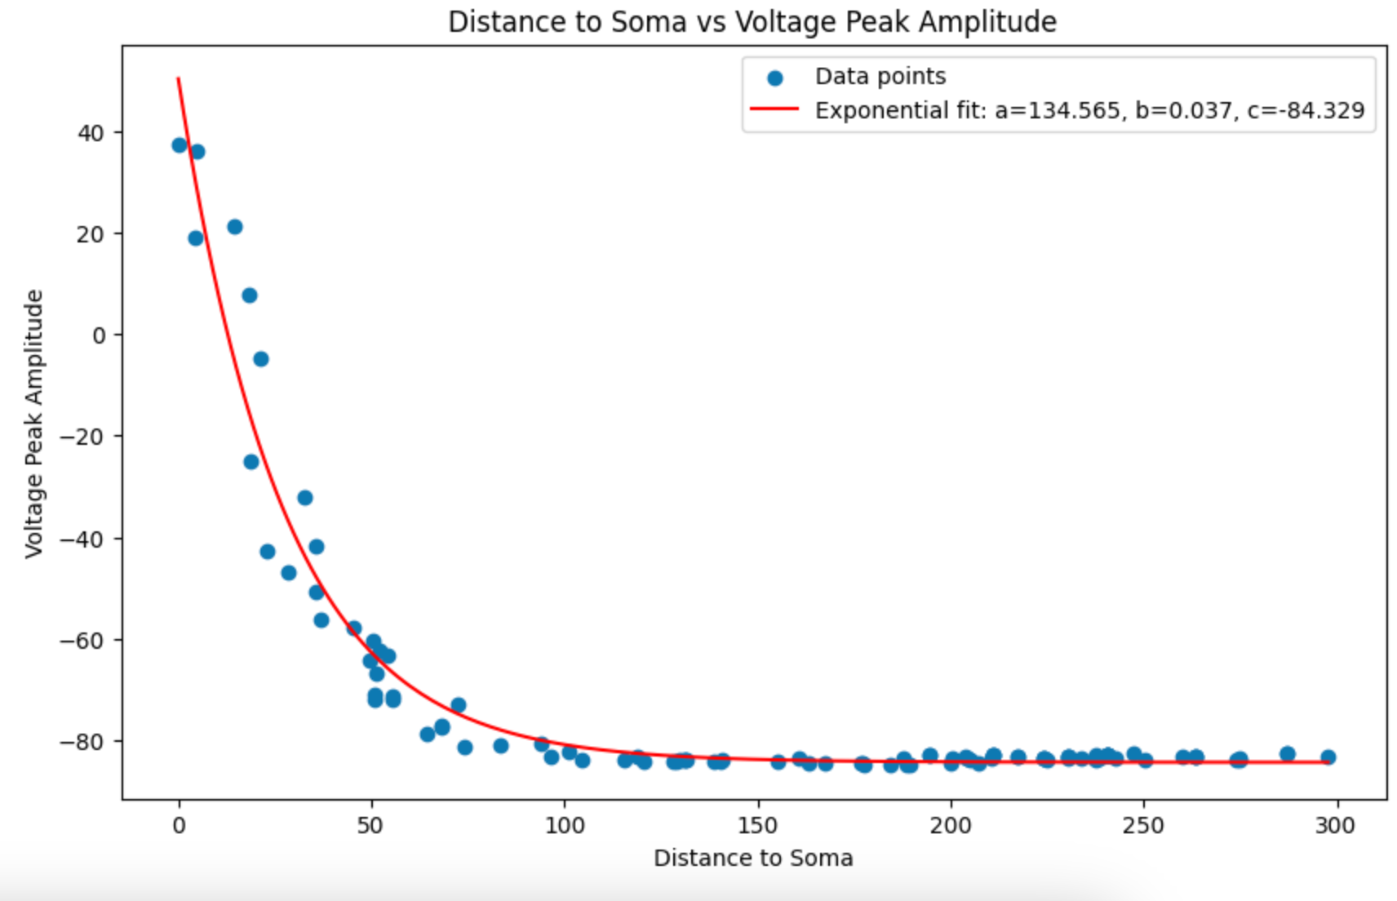
BlueCellulab
github.com/BlueBrain/BlueNaaS-SingleCell
github.com/BlueBrain/BlueCelluLab

Slide 22

BluePyEModel — pipeline for building single cell e-models
eFEL — Electrophys Feature Extraction Library
BluePyEfe — E-feature extraction
BluePyOpt — Parameter optimisation Library
BlueCelluLab — Perform simulations on a single cell or group of cells
Currentscape — Easily plot and visualize currents and ionic concentration in electrical neuron models
BluePyMM — Model management for circuit building
EModelRunner — Runs cells from stand-alone packages
BlueNaaS-SingleCell — Interacts with single cell models through a web application
github.com/BlueBrain/singlecell-emodel-suite

Slide 23
Thank You!

